Slide 1
Module 5(Part 1): Sorting
Sorting Techniques – Selection Sort, Insertion Sort, Quick Sort, Merge Sort and Heap Sort

Slide 2
Arranging data in some order is called as sorting.
Two Properties of Sorting Techniques:
  Stable: If the sorting algorithm preserves the relative order of any two equal elements.
  In Place: If the algorithm doesn’t require an extra memory space.

Slide 3
Sorting Techniques
    Bubble Sort
    Selection Sort
    Insertion Sort
    Merge Sort
    Quick Sort
    Heap Sort

Slide 4
Bubble Sort
Also Known as exchange sort.
Repeatedly goes through the list, comparing two adjacent items at a time and swapping them if they are in wrong order.
The pass through list is repeated until no swaps are needed i.e. until List is sorted.

Slide 5
25 17 31 13 2
17 25 13 2 31
17 25 31 13 2
17 25 13 2 31
17 25 31 13 2
17 13 25 2 31
17 25 13 31 2
17 13 2 25 31
17 25 13 2 31

Slide 6
17 13 2 25 31
13 2 17 25 31
13 17 2 25 31
2 13 17 25 31
13 2 17 25 31

Slide 7
Bubble Sort Algorithm
1. for(i =0; i<n; i++) do
1.1 for(j=0;j<n-i;j++) do
1. if(a[j]>a[j+1]) then
a) temp=a[j];
b) a[j]=a[j+1];
c) a[j+1]=temp
1.2 End For
2. End For
Time Complexity = O(n²)

Slide 8
Selection Sort
Repeatedly find the largest or smallest element and move it to its final position in the sorted array.
Procedure:
The 0th index element is compared with all other elements. If zeroth index element is found larger then they will be swapped.
After first iteration the smallest element will occupy the first position.
In second iteration 1st element is compared with all other elements and the process continues.

Slide 9
25 17 31 13 2
2 25 31 17 13
17 25 31 13 2
2 25 31 17 13
2 17 31 25 13
17 25 31 13 2
2 13 31 25 17
13 25 31 17 2
2 25 31 17 13

Slide 10
2 13 31 25 17
2 13 17 31 25
2 13 17 25 31
2 13 25 31 17
2 13 17 31 25

Slide 11
Algorithm(Selection Sort):
1. for i=0 to n-2 do
1.1 for j=i+1 to n-1 do
1. if(a[i]>a[j]) then
temp=a[i]
a[i]=a[j]
a[j]=temp
1.2 End For
2. End For
Time Complexity = O(n²)

Slide 12
Insertion Sort
In every iteration an element is compared with all elements before it.
Procedure:
In first iteration 1st element is compared with 0th element.
In second iteration 2nd element is compared with 0th and 1st elements
In third iteration 3rd element is compared with 0th, 1st and 2nd element.

Slide 13

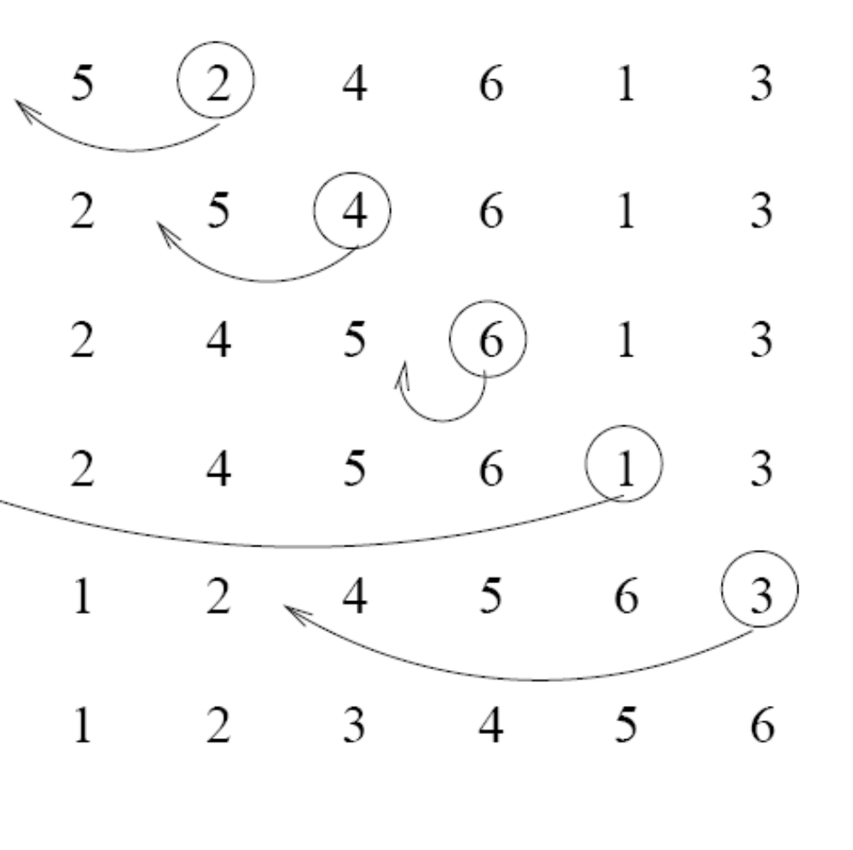




Insertion Sort

Slide 14
Algorithm:Insertion Sort
1.For i=1 to n-1
1.1 set temp=a[i]
1.2 set j=i-1
1.3 while(j>=0 and a[j]>temp) do
1. a[j+1]=a[j]
2.j=j-1
1.4. Endwhile
1.5. a[j+1]=temp;
2.Endfor
Time complexity = O(n²)

Slide 15
Merge Sort
Merge Sort works as follows
1. Divide the unsorted list into n sublists, until each sublist contain only 1 element.
2. Repeatedly merge the sublists to produce new sublist until there is only one sublist remaining.
While merging each sublist is sorted individually and the resulted sorted sublists are merged to produce a single sorted sequence of n element.

Slide 16
how the sequence is divided
85
24
63
45
17
31
96
50
85
24
63
45
17
31
96
50
85
24
63
45
17
31
96
50
85
24
63
45
17
31
96
50

Slide 17
how the sequences are merged
17
24
31
45
50
63
85
96
24
45
63
85
17
31
50
96
24
85
45
63
17
31
50
96
85
24
63
45
17
31
96
50

Slide 18
Merge Sort Recursive
Int a[20];
void mergesort(int low, int high)
{
int mid;
if(low < high)
{
mid = floor( (low+high) / 2);
mergesort(low, mid);
mergesort(mid+1, high);
merge(low, mid, high);
}
}
void merge(int low, int mid, int high)
{
int b[20];
int i, j, k;
k = 0;
i = low;
j = mid+1;
while(i <= mid && j <= high)
{
if(a[i] < a[j])
{
b[k] = a[i];
k++;
i++ ;
}
else{
b[k] = a[j];
k++;
j++;
}
}

Slide 19
while(i <= mid)
{
b[k] = a[i];
k++;
i++;
}
while(j <= high)
{
b[k] = a[j];
k++;
j++;
}
for(i=high; i >= low; i--)
{
k--;
a[i] = b[k]; // copying back the sorted list to a[]
}
}

Slide 20
void main()
{
int i,n;
printf(“ Enter array size : ");
scanf("%d",&n);
printf("\n Enter array elements");
for(i=0;i<n;i++)
scanf("%d",&a[i]);
mergesort(0,n-1);
printf("\nThe final sorted list is :\n ");
for(i=0;i<n;i++)
printf("%d ",a[i]);
}

Slide 21
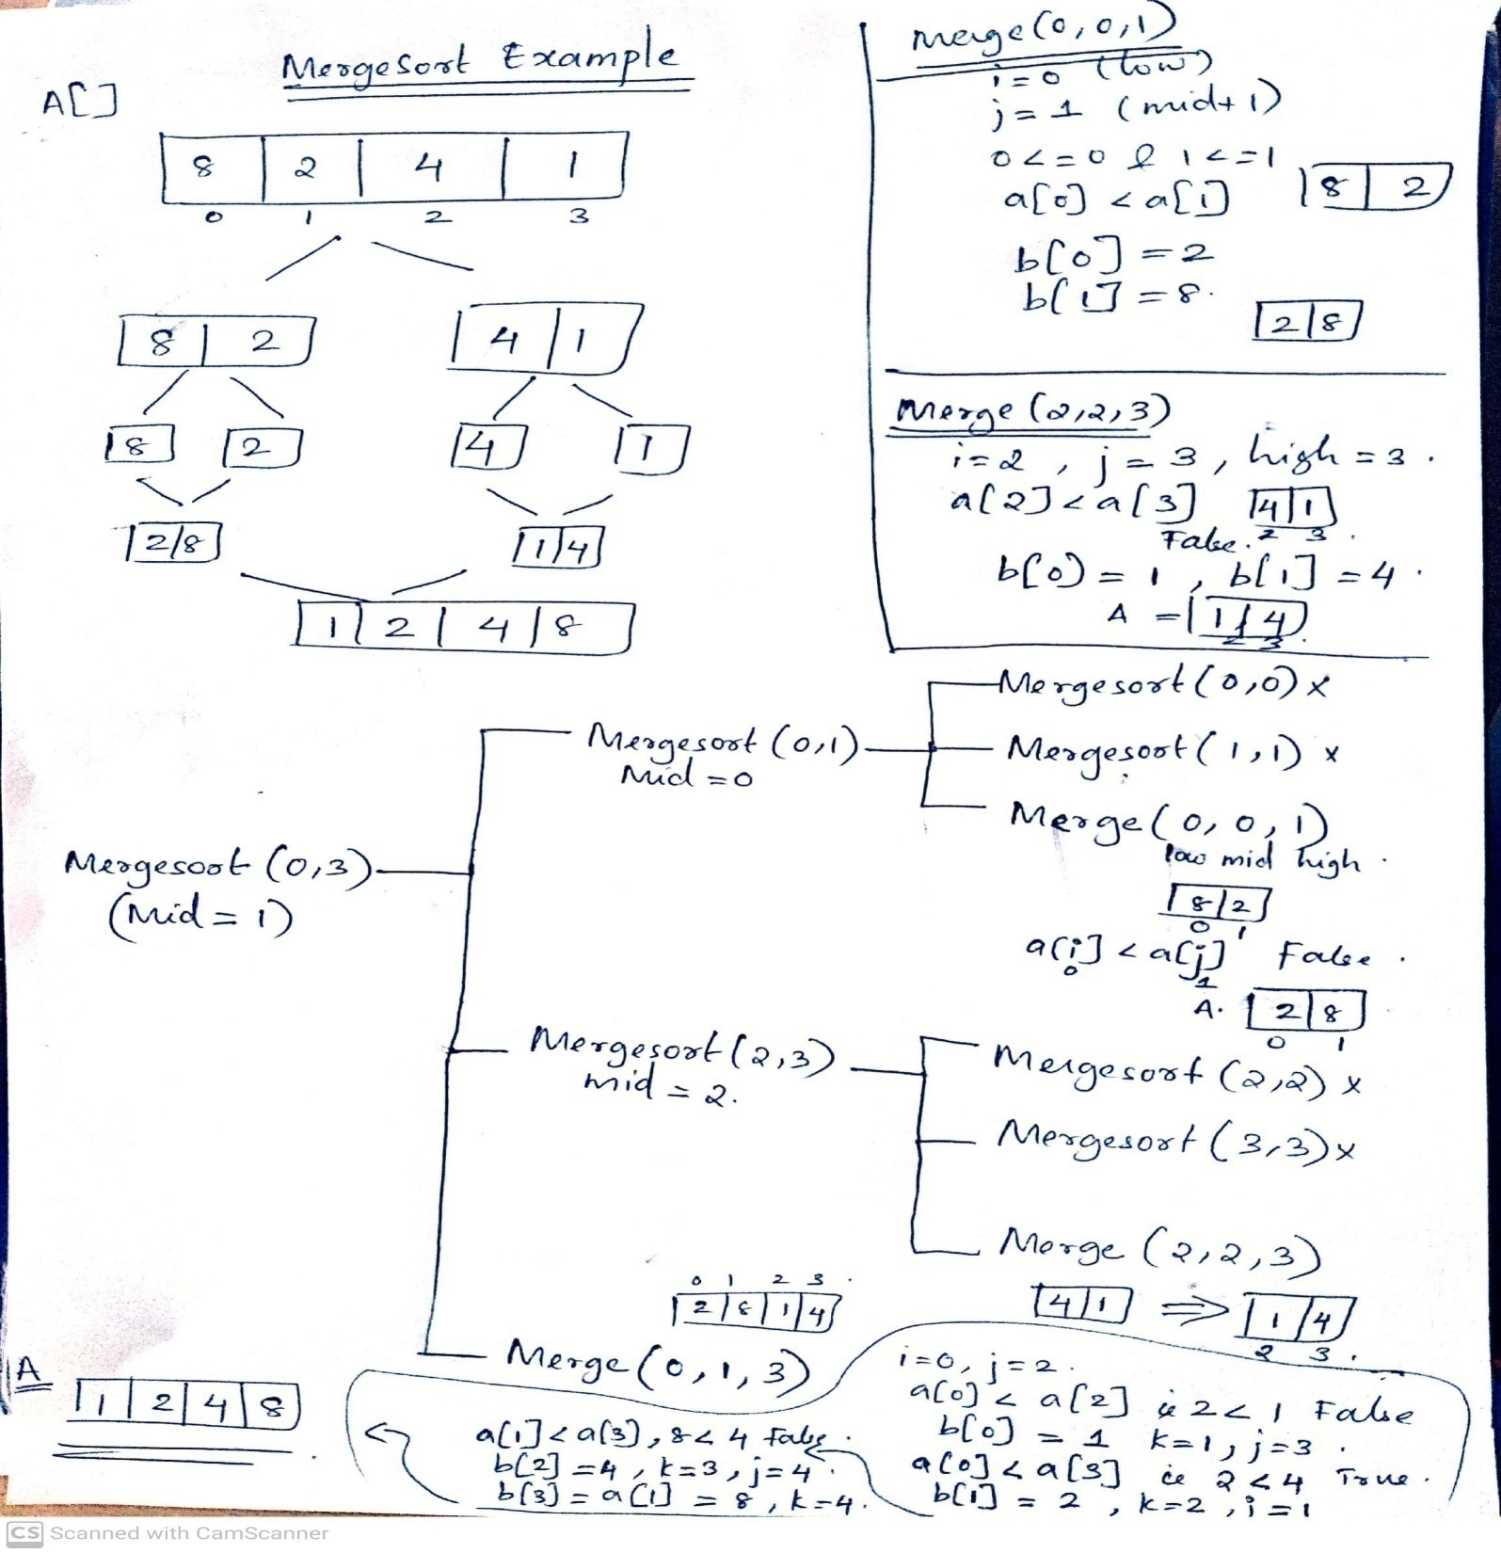

Slide 22
Quick Sort
Divide and Conquer Technique
Procedure
  pick one element to use as pivot.
  partition elements into two sub-arrays:
    Elements less than pivot
    Elements greater than pivot
  Quicksort the two sub-arrays
  Return results

Slide 23
Choosing Pivot element position
We are given array of n integers to sort:
Pivot element is 41(first element)
To place 41 in its right position, compare it with right end(28), swap the elements if they are not ordered
41
79
65
35
21
48
59
87
52
28
41
79
65
35
21
48
59
87
52
28
28
79
65
35
21
48
59
87
52
41

Slide 24
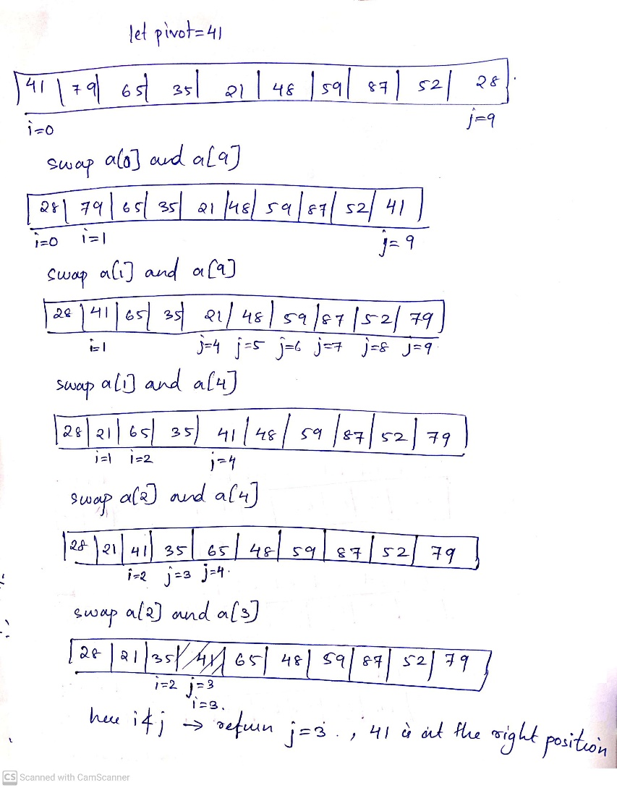

Slide 25
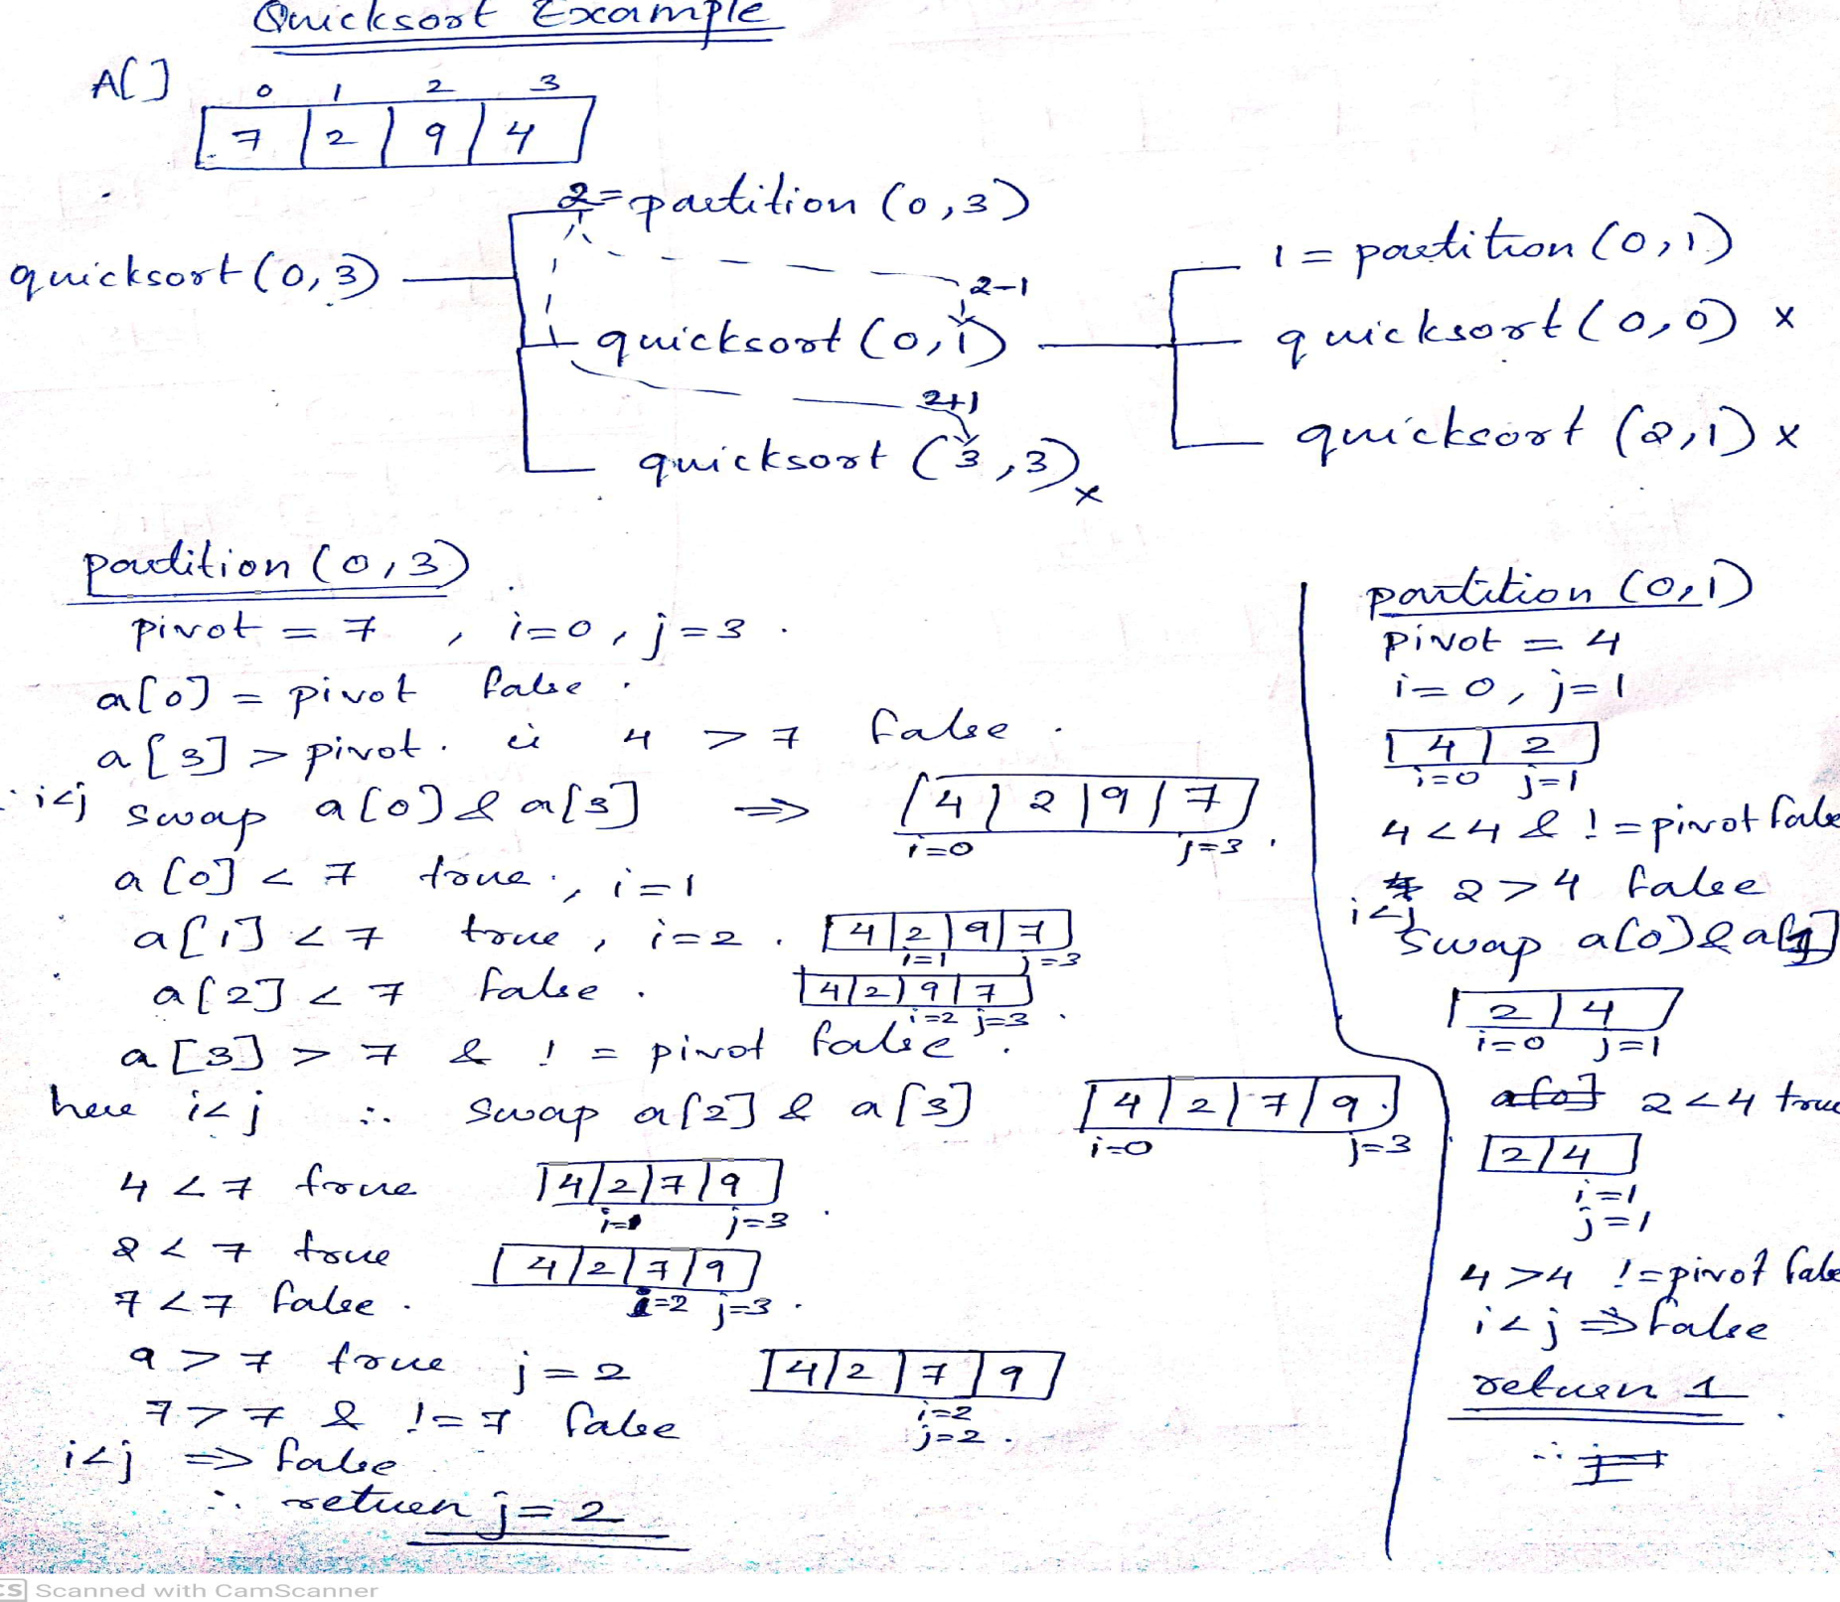

Slide 26
Initial fn call: quicksort(0,n-1) here 0: starting index, n-1 : last index of a
void quicksort(int low, int high)
{
if(low < high)
{
int p;
p = partition(low, high);
quicksort(low, p-1);
quicksort(p+1, high);
}
}

Slide 27
int partition(int low, int high)
{
int i, j, pivot, temp;
pivot = a[low];
i = low;
j = high;
while(1)
{
while(a[i] < pivot && a[i] != pivot)
i++;
while(a[j] > pivot && a[j] != pivot)
j--;
if(i < j)
{
temp = a[i];
a[i] = a[j];
a[j] = temp;
}
else
return j;
}
}

Slide 28
Heap Sort
Def: A heap is a complete binary tree with the following two properties:
  Structural property: all levels are full, except possibly the last one, which is filled from left to right
  Order (heap) property: for any node x
  Parent(x) ≥ x
From the heap property, it follows that:
“The root is the maximum element of the heap!”
8
7
4
2
5
Heap

Slide 29
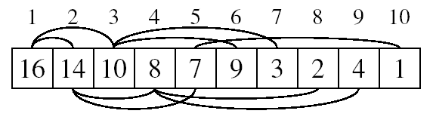
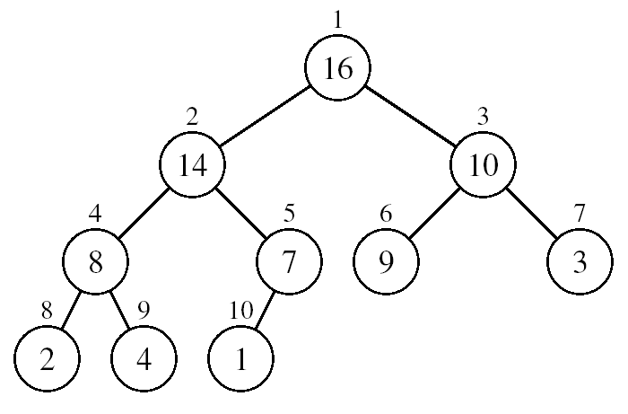
A heap can be stored as an array A.
  Root of tree is A[1]
  Left child of A[i] = A[2i]
  Right child of A[i] = A[2i + 1]
  Parent of A[i] = A[ ⎣i/2⎦ ]

Slide 30
Heap Types
Max-heaps (largest element at root), have the max-heap property:
  for all nodes i, excluding the root:
  A[PARENT(i)] ≥ A[i]
Min-heaps (smallest element at root), have the min-heap property:
  for all nodes i, excluding the root:
  A[PARENT(i)] ≤ A[i]

Slide 31
Procedure for Sorting using Heap Tree
1. Create a max-heap from an unordered array by adjusting elements of an array.
2. After the creation of heap, now remove the root element of the heap by shifting it to the end of the array. (here root has the maximum value)
3. Reduce the size of array by 1 and maintain/restore the max-heap property for the remaining elements.
4. Repeat steps 2-3 till one element remains

Slide 32
Alg: HEAPSORT(A)
Assume n is the size of array declared globally.
Call BUILD-MAX-HEAP(A)
For i = n to 2 do
1. Swap A[1] and A[i]
2. n=n-1
3. Call MAX-HEAPIFY(A, 1,n)
3. End For

Slide 33
Building a Heap
Convert an array A[1 … n] into a max-heap
The elements in the subarray A[(⎣n/2⎦+1) .. n] are leaves
Apply MAX-HEAPIFY on elements between 1 and ⎣n/2⎦
Alg: BUILD-MAX-HEAP(A)
for i ← ⎣n/2⎦ down to 1 do
Call MAX-HEAPIFY(A, i, n)
1
4
2
3
1
3
4
5
6
7
2
16
9
10
8
9
10
14
8
7
A:
4 | 1 | 3 | 2 | 16 | 9 | 10 | 14 | 8 | 7

Slide 34
Maintaining the Heap Property
Alg: MAX-HEAPIFY(A, i, n)
l = 2*i
r = 2*i+1
if l ≤ n and A[l] > A[i]
4.1. largest =l
Else
  1. Largest = i
5. if r ≤ n and A[r] > A[largest]
5.1. largest = r
if largest ≠ i
6.1.Exchange A[i] and A[largest]
6.2. Call MAX-HEAPIFY(A, largest, n)

Slide 35
Example: A
4 | 1 | 3 | 2 | 16 | 9 | 10 | 14 | 8 | 7
i = 5
i = 4
i = 3
1
1
1
4
4
4
2
3
2
3
2
3
1
3
1
3
1
3
4
5
6
7
4
5
6
7
4
5
6
7
2
16
9
10
2
16
9
10
14
16
9
10
8
9
10
8
9
10
8
9
10
14
8
7
14
8
7
2
8
7
i = 2
i = 1
1
1
1
4
4
16
2
3
2
3
2
3
1
10
16
10
14
10
4
5
6
7
4
5
6
7
4
5
6
7
14
16
9
3
14
7
9
3
8
7
9
3
8
9
10
8
9
10
8
9
10
2
8
7
2
8
1
2
4
1

Slide 36
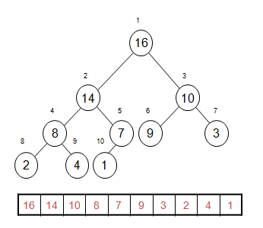
Result after BUILD-MAX-HEAP on A[]=4, 1, 3, 2, 16, 9, 10, 14, 8, 7.
Swap A[1]<->A[10].
Then call MAX-HEAPIFY(A,1,n-1)

Slide 37
Time Complexities
Bubble Sort O(n²)
Selection Sort O(n²)
Insertion Sort O(n²)
Heap Sort O(n log(n))
Quick Sort O(n²)
Merge Sort O(n log(n))

